Slide 1
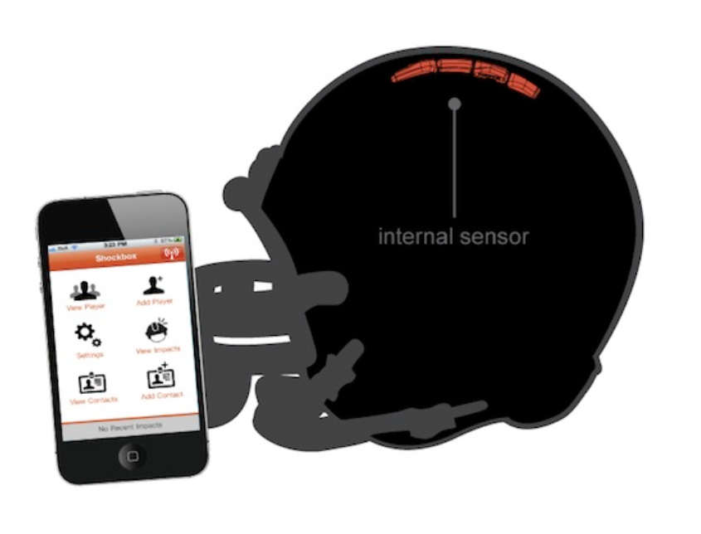
Helmet Integrated Impact
Detection System
(HI-IDS)
Presenter: Rhyan Gonzalez
Role: Hardware Design

Slide 2
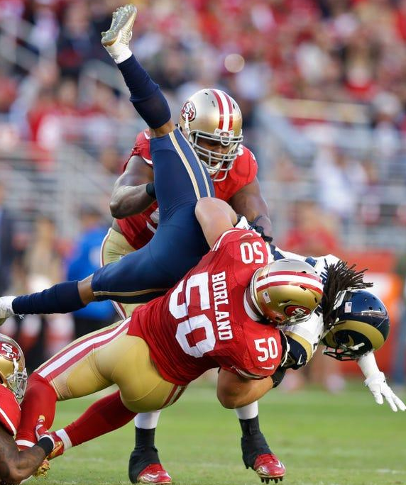
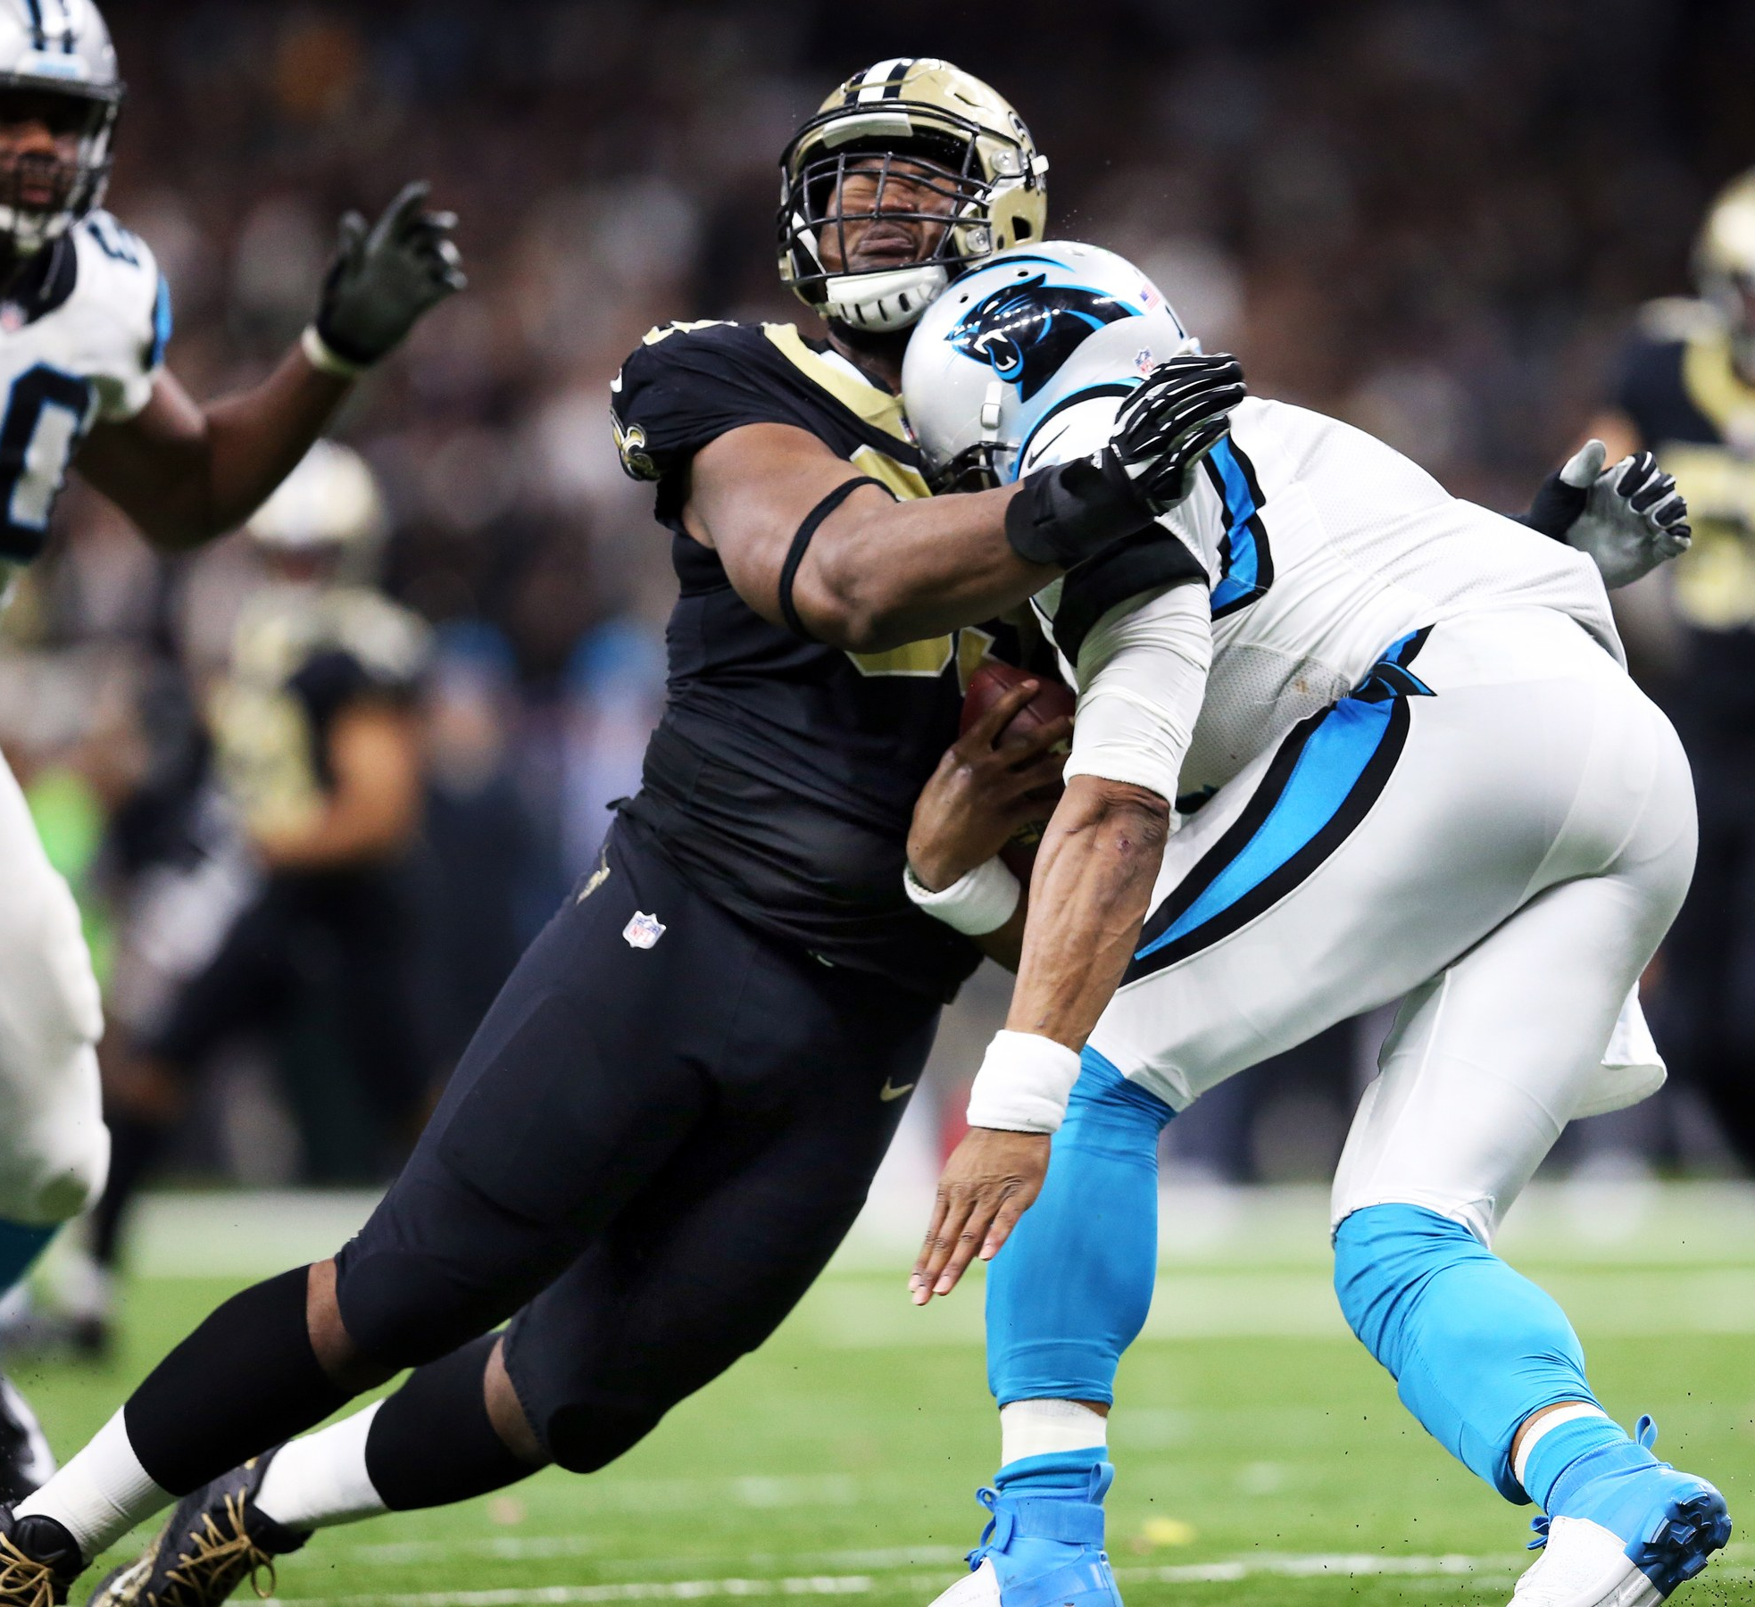
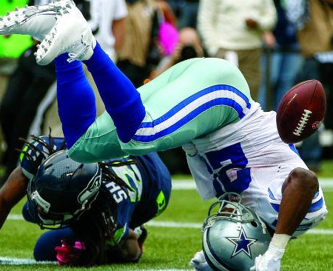
Concussions are common in Football !
Figure 1. NFL players making helmet on helmet contact.

Slide 3

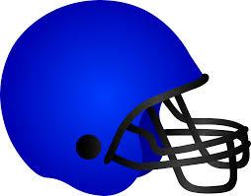


HI-IDS is Designed to Lower Brain
Damages in Players
Measures the g-force of collisions
Alerts coaches when a player is in danger of a concussion
Notes:
While at the same time … is durable and comfortable enough to be used like any regular football helmet
The software connect to the helmet will enable … to monitor…. And send alerts ..

Slide 4

Overview
Team
Background and Reasoning
Updated System Requirements
Reviewing Standards and Safety Summaries
Key System Requirements
Summarized Acceptance Tests
Perform Demo
Selected Acceptance Tests
Summary

Slide 5




Building HI-IDS with Qualified Team Members
Jasmine Arrieta
Role: Hardware Design
Emphasis: Electronics
Experience: 3D Printing, Creo, Python, Power Systems
Calvin Lee
Role: Software testing &
development
Emphasis: Communications
Experience: C++ / Python
Rhyan Gonzalez
Role: Hardware Design
Emphasis: Electronics
Experience: C++, VHDL, Matlab
Socheath Sok
Role: Software Design
Emphasis: BME
Experience: MATLAB, Simulink, VHDL, & Assembly

Slide 6
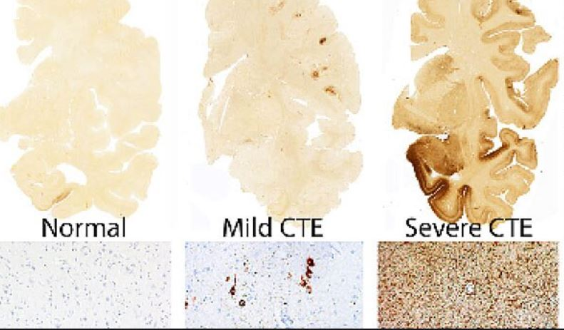
Multiple Concussions Are Life-threatening
A concussion occurs when a person’s head is jostled, shook, or hit.
Unbalanced
Short Term Memory Loss
Blurred Vision
Athletes are at higher risk of developing a neurodegenerative disease later in life
CTE (chronic traumatic encephalopathy)
Self-diagnosing Is unreliable

Slide 7
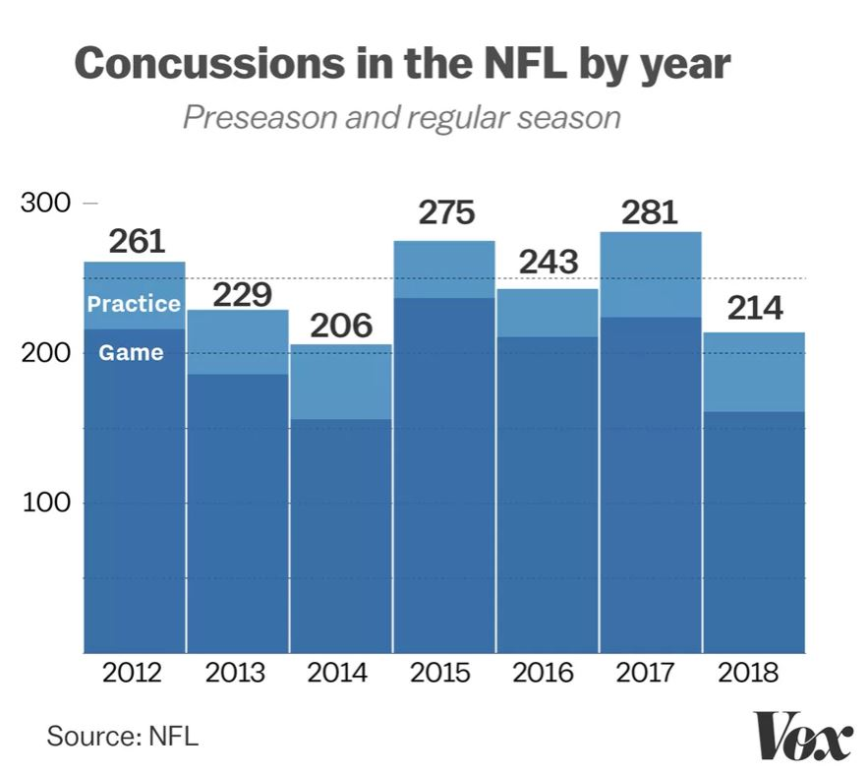
Multiple and Repeated Concussions In Football

Slide 8
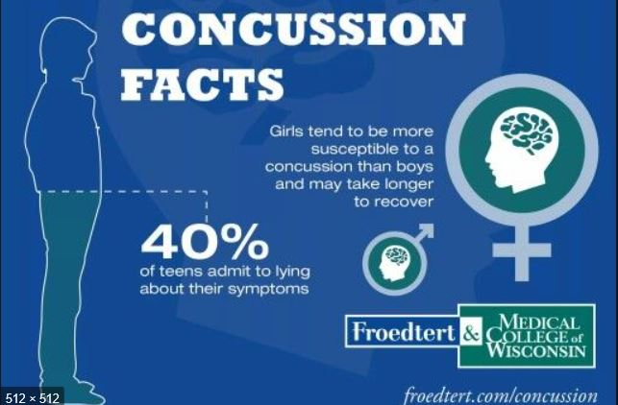
Underreporting Concussions Is Common

Slide 9
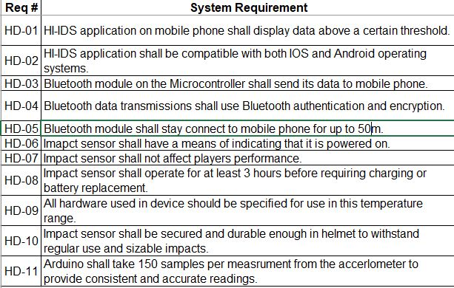
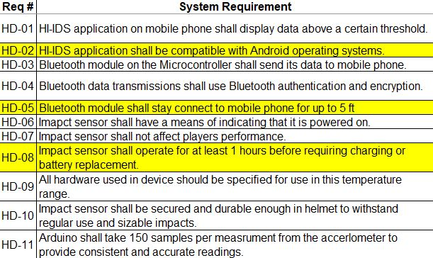
Updating System Requirements
Previous System Requirements
Updated System Requirements

Slide 10

No Updates to Standards and Safety
IEC 60086-4 Ed. 4.0 b:2014
Primary batteries - Part 4: Safety of lithium batteries
IEEE 802.11b-1999
IEEE Standard for Information Technology - Telecommunications and information exchange between systems - Local and Metropolitan networks - Specific requirements - Part 11: Wireless LAN Medium Access Control (MAC) and Physical Layer (PHY) specifications: Higher Speed Physical Layer (PHY) Extension in the 2.4 GHz band
IEEE 836-2001
IEEE Recommended Practice for Precision Centrifuge Testing of Linear Accelerometers
ISO/IEC 9126-1:2001
Software engineering — Product quality — Part 1: Quality model
UHS-III
UHS-III SD Memory Card Standard
Notes:
Battery standards
Telecommunication standards,
Accelerometers standards,
Product quality standards,
Memory card standards.

Slide 11
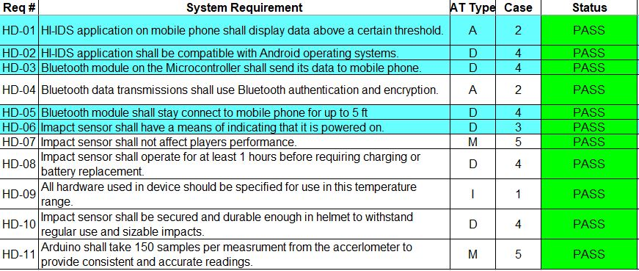

Testing Key System Requirements
Notes:
Bluetooth Connectivity requirements
OS compatibility requirements
Operation requirements ( temperature, G force)
Accuracy requirements (

Slide 12
Summarizing Acceptance Test Results
Notes:
Bluetooth Connectivity requirements
OS compatibility requirements
Operation requirements ( temperature, G force)
Accuracy requirements (

Slide 13

Demoing Key Functionalities
Measure collisions to the helmet
Transmit the data collected from the helmet wirelessly to an app
Send an alert on the app when a helmet collision exceeds a certain threshold
Display a history of impact data over a selected period of time

Slide 14

Selected Acceptance Tests

Slide 15
Concussions are common in Football !
Figure 1. NFL players making helmet on helmet contact.

Slide 16
HI-IDS is Designed to Lower Brain
Damages in Players
Measures the g-force of collisions
Alerts coaches when a player is in danger of a concussion
Notes:
While at the same time … is durable and comfortable enough to be used like any regular football helmet
The software connect to the helmet will enable … to monitor…. And send alerts ..

Slide 17
Questions? Thank you!

